Slide 1
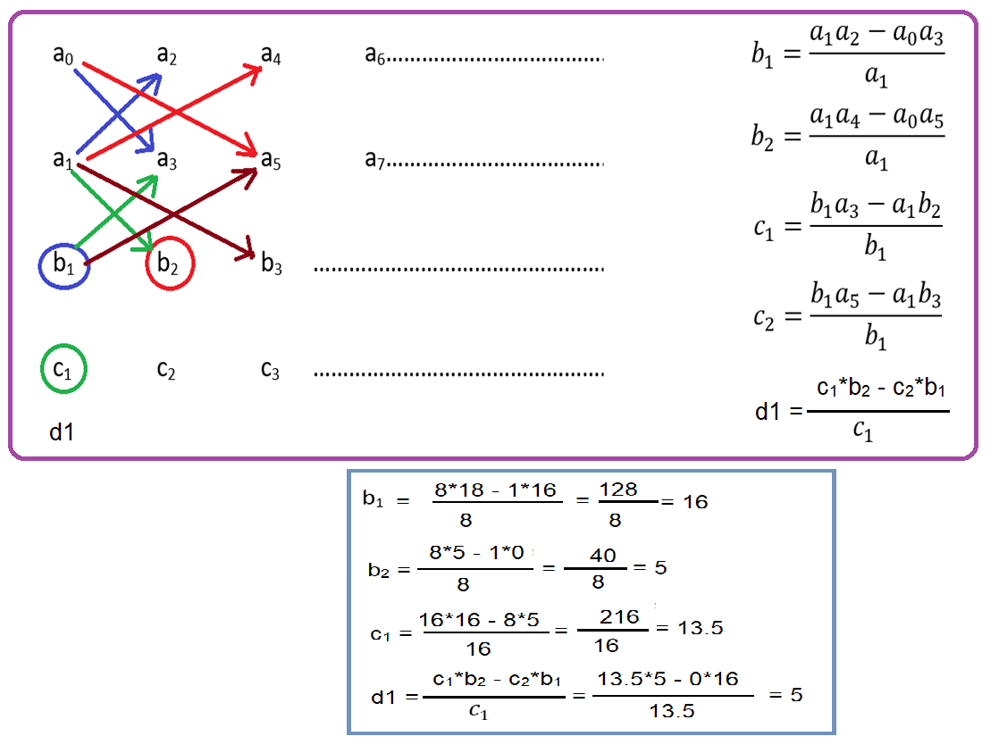

Slide 2
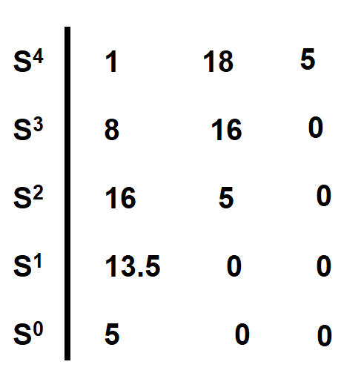
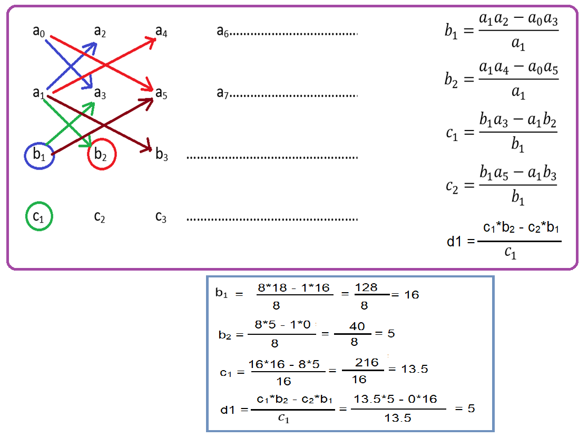
Q: Apply the routh array, determine the stability of the system represented by the characteristics equation S⁴ + 8S³ + 18S² + 16S + 5 = 0
https://www.muchen.ca/RHCalc/
System is Stable, because first column all +ve no sign is changed

Slide 3
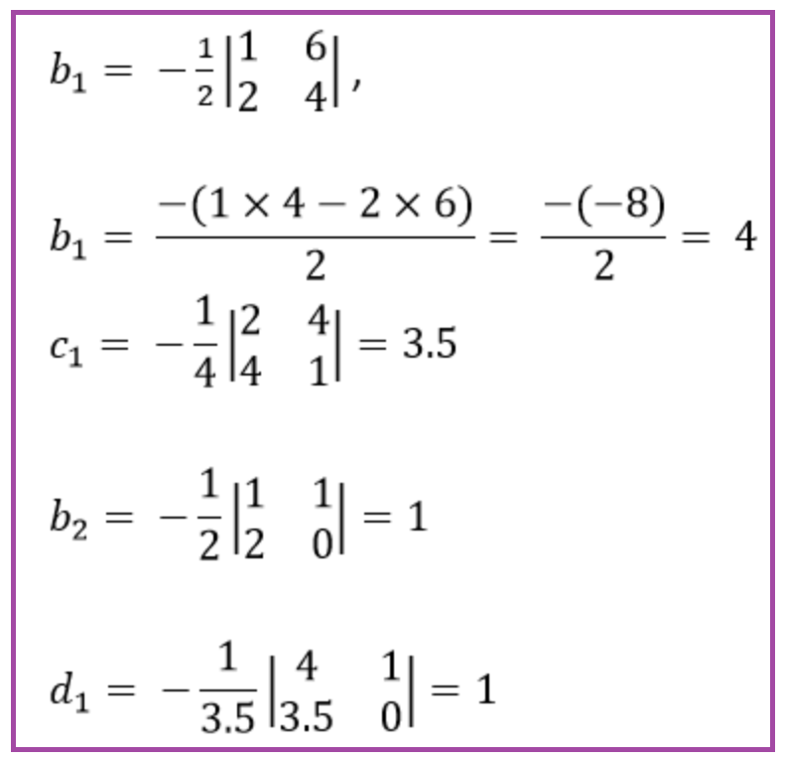
Q: Apply the routh array, determine the stability of the system represented by the characteristics equation S⁴ + 2S³ + 6S² + 4S + 1 = 0
S⁴ 1 6 1
S³ 2 4 0
S² 4 1
S¹ 3.5
S⁰
Since all the coefficients in the first column are of the same sign, i.e., positive, the given equation has no roots with positive real parts; therefore, the system is said to be stable.

Slide 4
Q: Given the characteristics equation: a(S) = S⁶ + 4S⁵ + 3S⁴ + 2S³ + S² + 4S + 4 = 0 Is the system described by this characteristics equation stable?
S⁶ 1 3 1 4
S⁵ 4 2 4
S⁴ 5/2 0 4
S³ 2 -12/5 0
S² 3 4
S¹ -76/15 0
S⁰ 4
The elements of the 1st column are not all positive. Then the system is unstable

Slide 5
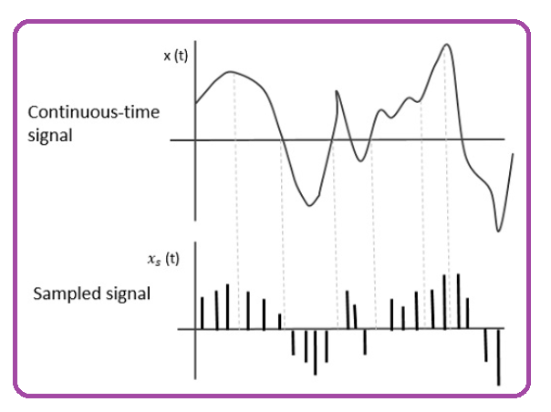
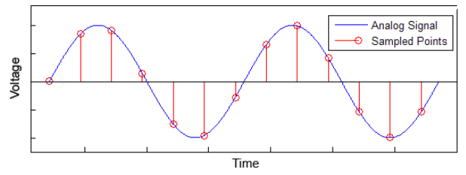
Sampling Theorem/Nyquist Theorem
Sampling:
Sampling is the process of conversion of a continuous-time signal into a discrete-time signal is known as Sampling.
Sampling is the process of the reduction of a continuous-time signal into a discrete time signal is known as Sampling.

Slide 6
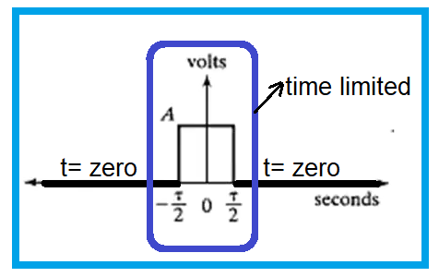
Time Limited Signal
A Time Limited Signal is one that is nonzero only for a finite length of time interval.
Finite length of time interval means suppose t = 5 and -5 or t = 4 to 9, for a particular time duration signal is non-zero and for any other time interval is zero is known as Time Limited Signal, because it is bounded one particular time interval .

Slide 7
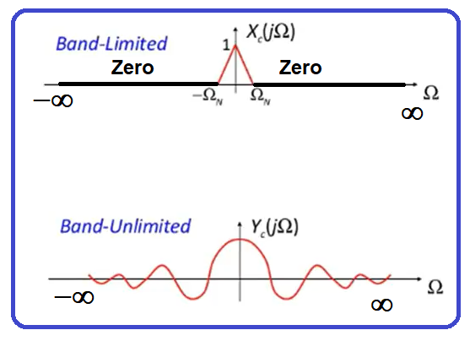
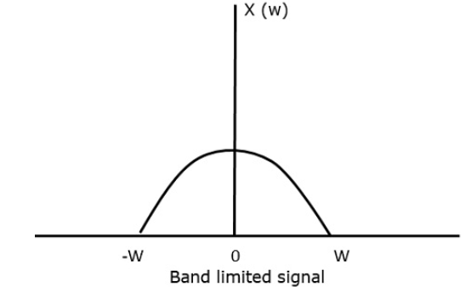
Band Limited Signal
A Band-Limited signal is one type of signal, whose frequency response is limited or not equal to zero for a particular frequency band and for all other frequency value of signal is zero.
A band limited signal is a signal in which only some particular-band of frequencies are present.
A Band-limited signal is one whose Fourier Transform is non-zero on only a finite interval of the frequency axis.

Slide 8
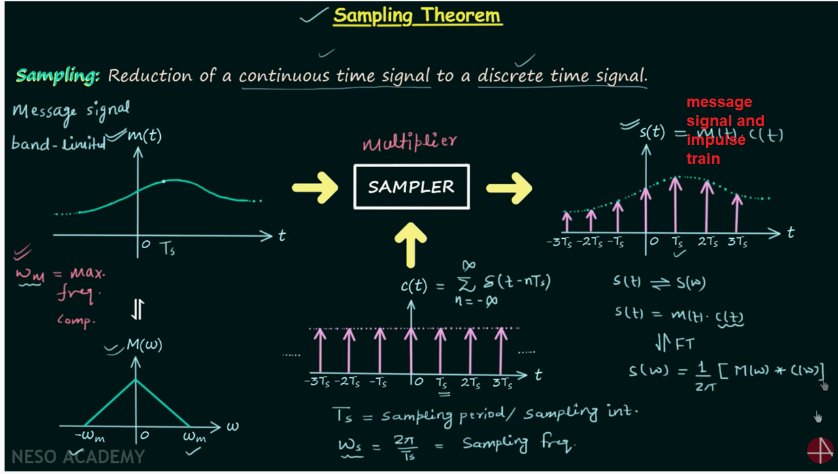

Slide 9
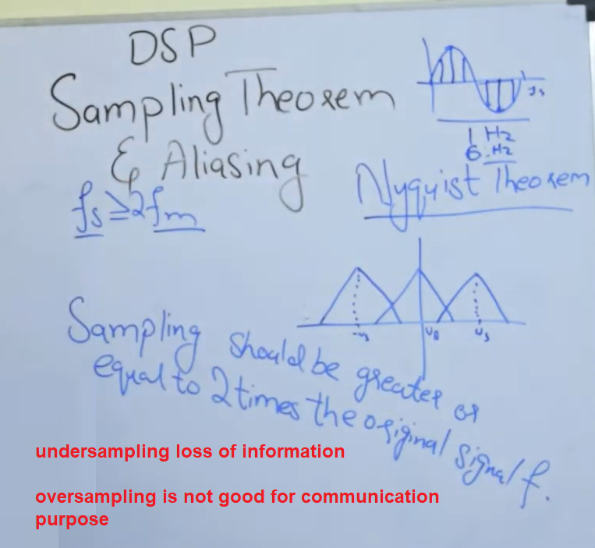
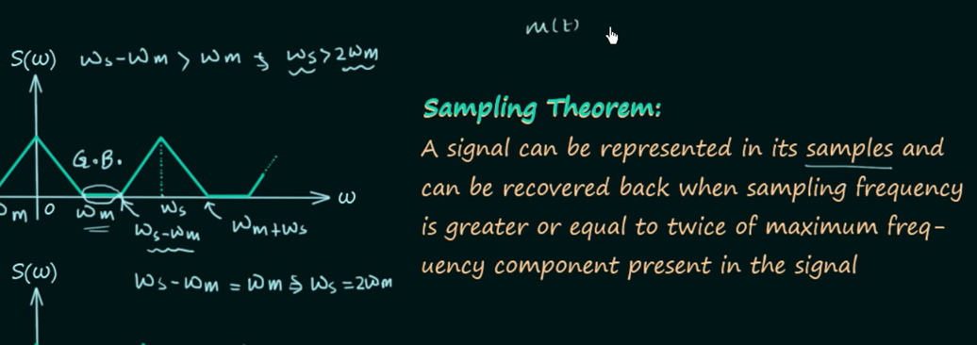
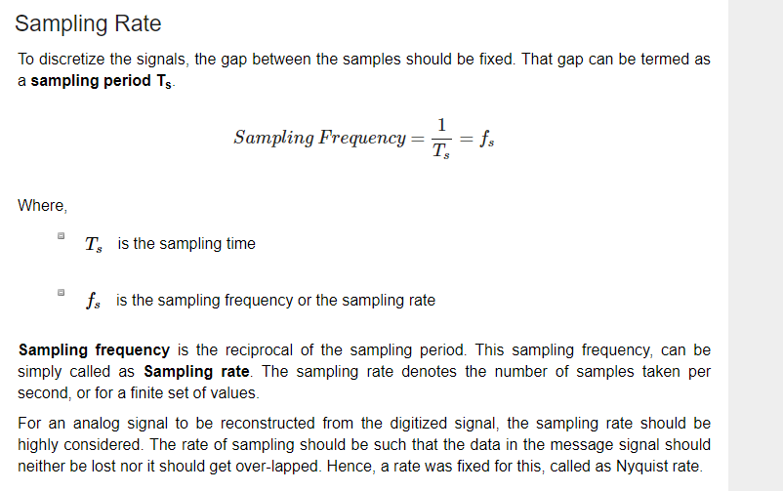
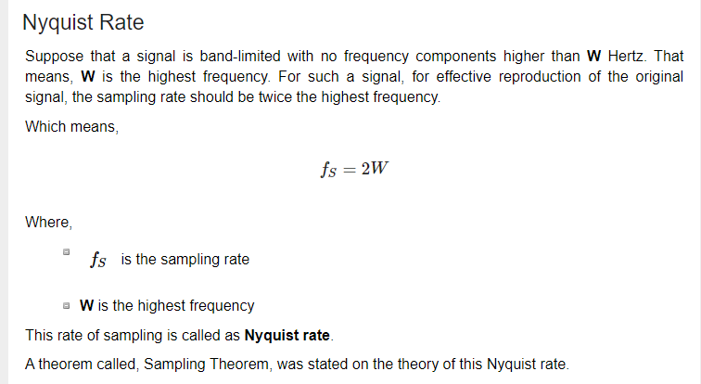
Sampling Theorem

Slide 10
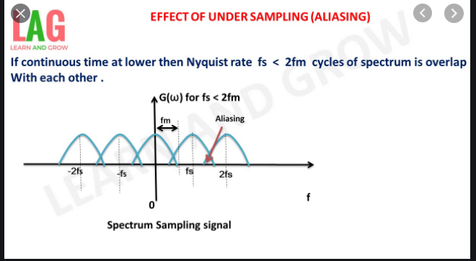
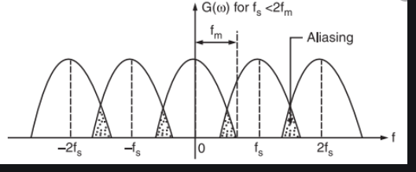
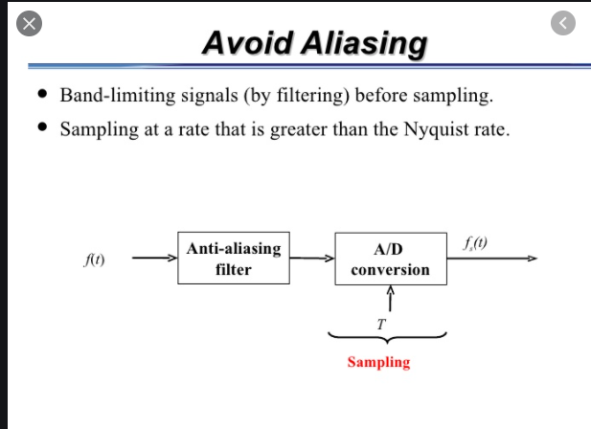

Slide 11
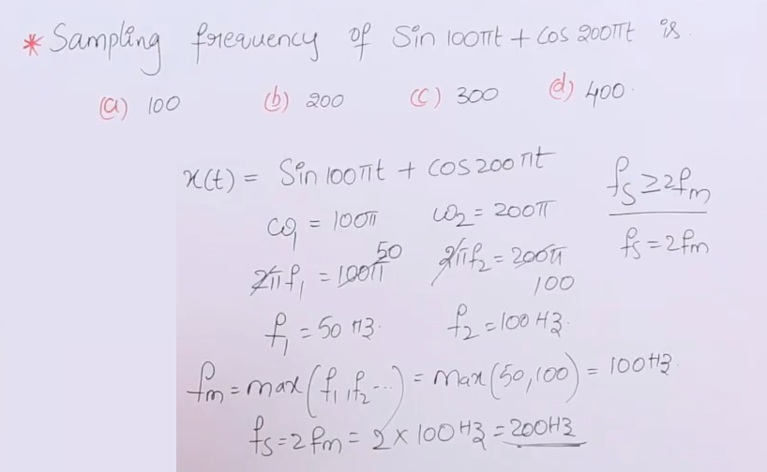

Slide 12
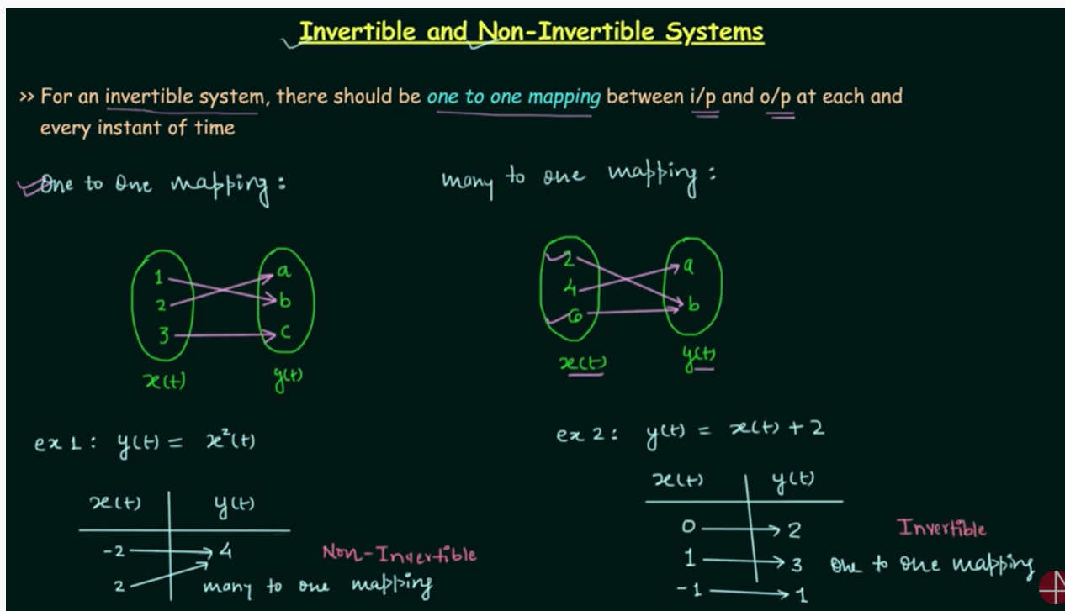

Slide 13
